Slide 1



Renovating The Steward Observatory Student Radio Telescope
Arizona/NASA Space Grant Statewide Symposium
Arizona State University
April 17-18, 2009
BY: Adrian Lizarraga
Mentor: Dr. Christopher Groppi
Astronomy Department
University of Arizona
Notes:
Title, Name, Mentor’s Name, Mentor’s affiliation, Date, Space Grant Logo

Slide 2
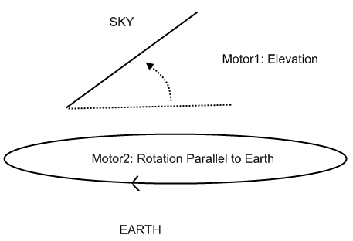
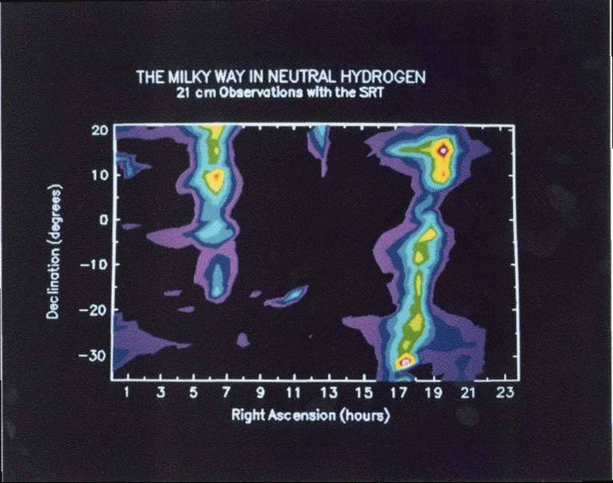
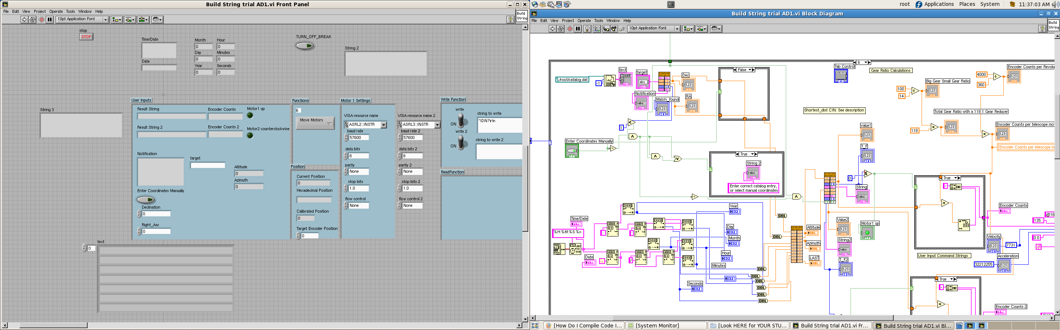
Radio Telescope Technical Details
Data Acquisition System:
Mechanical System:
LabVIEW: Visual Programming Language & Main Interface
Notes:
Original state of telescope, its purpose (including Michelle’s program) and my CHALLENGES

Slide 3
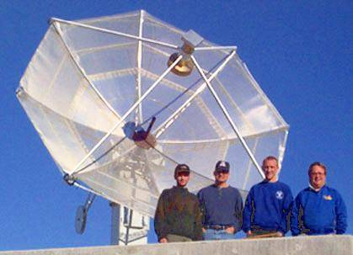
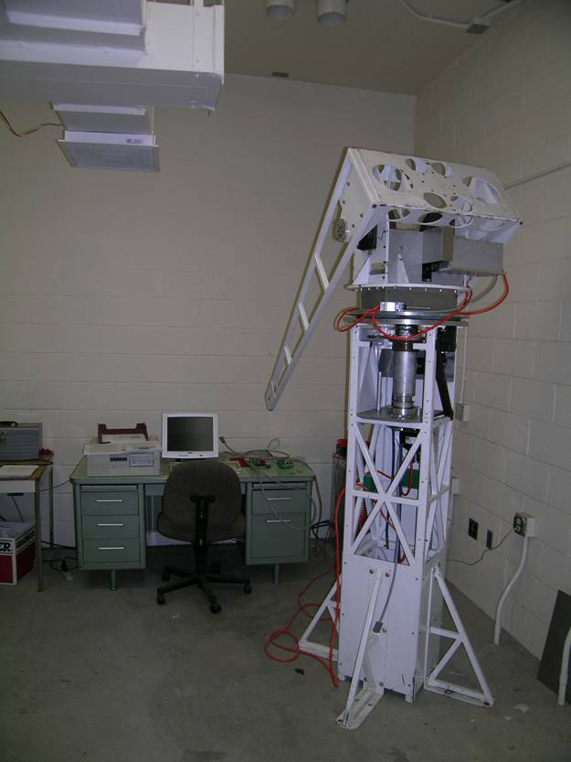
Original State of Project
Initially in active use
When I began:
  The data acquisition system was completed
  Telescope mount was mostly assembled
  Labview program interface could control one motor

Slide 4
My Tasks
Improve LabVIEW Interface: coordinate & tracking
program, catalog program, rotation control program
Construct current buffer circuit for brake system
Final Assembly

Slide 5
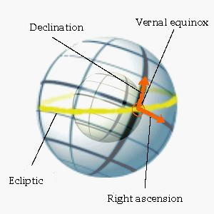
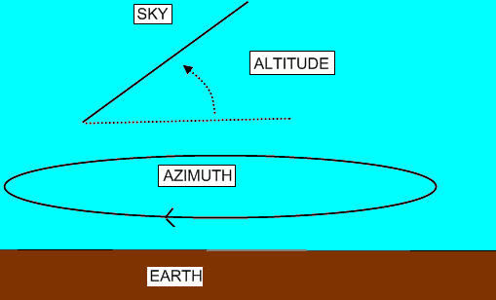
Equatorial VS Horizontal Coordinate Systems
Horizontal:
Equatorial:
Wikipedia.org
Location Dependent
Maps directly to motor rotations
Location Independent
Widely used

Slide 6
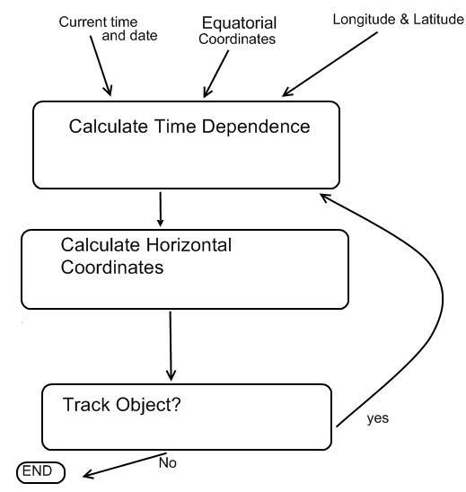
Coordinate Conversion and Tracking Program
Program Flow Chart:
Notes:
Main topic: Conversion and tracking program. How LST works and how program uses it.

Slide 7
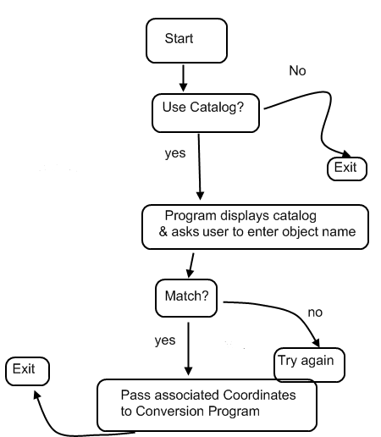
Catalog Program
Allows user to select a commonly used object/coordinate
Program Flow Chart:
Notes:
Catalog Program

Slide 8
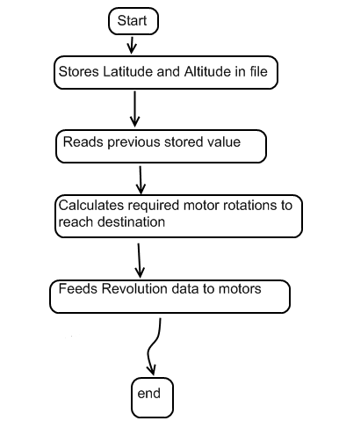
Rotation Control Program
Why is it needed?
  Interface/telescope has no memory of its location
  Consequently, moving to a different coordinate will be inaccurate.
Program Flow Chart:
Notes:
Rotation Control and mem program: what it does and why it’s necessary.

Slide 9
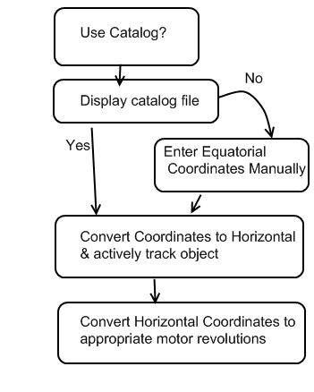
Overall Program Interface Flow
Flow Chart of all programs integrated within the LabVIEW interface

Slide 10
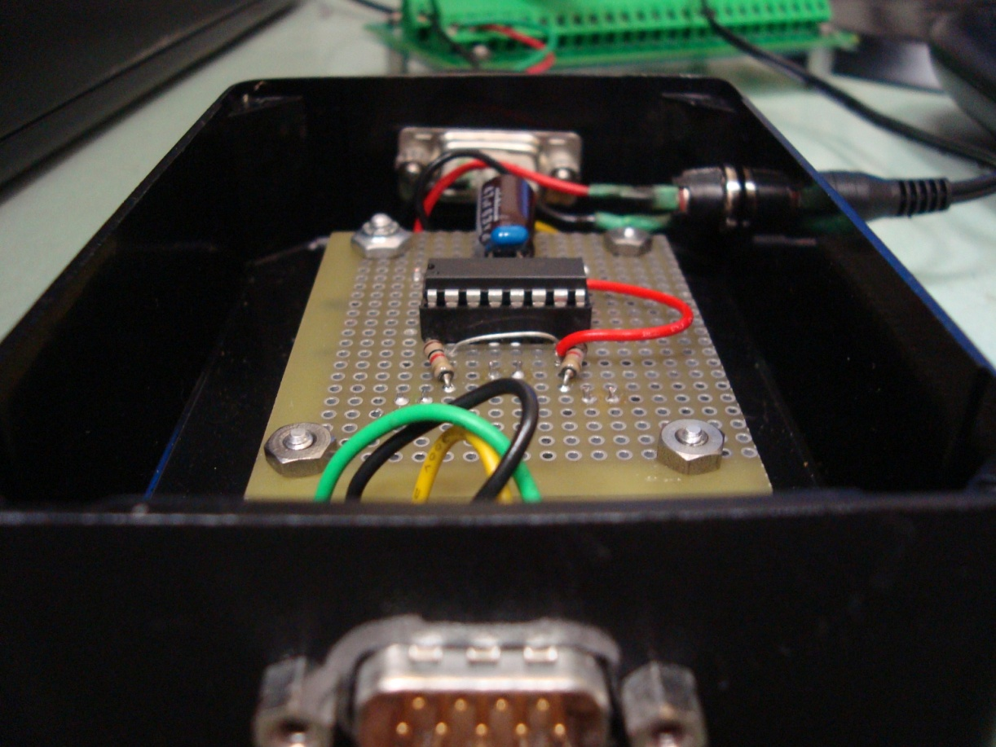
Motor Brake System
How it works: an electric signal opens a pneumatic solenoid valve, causing pressurized air to assert/release the breaks
Purpose: Lock motors in place when not in use
What I did: Built a separate buffer circuit to provide system with appropriate current
Notes:
Break system: explain box circuit and its need

Slide 11
Results and Direction
Current Status
Future Implications
Finishing assembly and final testing
Will mount the telescope by semester’s end.
Facilitate hydrogen mapping of our galaxy
Enable high school, undergraduate, and graduate students to more easily learn about radio astronomy
Notes:
Discuss Results and What it means for Research effort as a whole. What will it help astronomers accomplish?

Slide 12
Thank You!
Acknowledgements:
  Dr. Christopher Groppi (Mentor)
  Michelle Ho (Began Labview Interface)
  Bryan Cardwell (Data Acquisition System)
  Our ASU hosts!
  QUESTIONS?
Notes:
Thank you, Acknowledgements and Questions

